Slide 1

Team Huf
Your gateway to Fun Learning!
Notes:
Dear viewers, welcome to team huf presentation. I am Ng Chi Hui We are from lab TR2+. Our team consists of
Aileen Laskmono Lie
Ashwin Krup
Bachhas Nikita
Ong De Quan, Daniel
Rajuravi Vishal Raj
Sim Tian Quan
Song Yu
Teng Sok Ee
Zoe Lim
and myself Ng Chi Hui.

Slide 2
01
02
TABLE OF CONTENTS
03
04
Work Distribution
Introduction and Background
Functional Requirements
Non-Functional Requirements
Notes:
Today presentation flow will be as flows. First, the work distribution of the entire project, followed by intro and background, functional requirements and non functional requirements.

Slide 3
05
06
TABLE OF CONTENTS
07
08
System Architecture
Analysis Models
Subsystem Interface
Testing Methods
Notes:
We will also be discussing the system architecture, analysis models, subsystem interfaces as well as the testing methods.

Slide 4
01: Work Distribution
Name | Contribution
Aileen Laksmono Lie (U1920118E) | Deploy SQL database on AWS RDS, backend on heroku Facebook pop up page (frontend) Facebook Login APIs (backend) User signup API, Login API, Logout API (backend) Leaderboard API (backend) Dashboard API (backend) Dashboard frontend integration (frontend) Diagrams (Communication diagram, component diagram, ERD) Non-Functional Requirement
Ashwin Kurup (U1921557H) | Forget Password Backend System Architecture Integration Testing HufQuiz API HufQuizQn API HufQuizOption API HufQuizResult API
Bachhas Nikita (U1921630F) | Quiz Creation - Frontend Dialog Map Communication Diagram Use Case Description SRS Documentation Blackbox Testing Subsystem Interface
Notes:
This is the work distribution of the team, the speaker order of this presentation is not in the same order as the work distribution to ensure coherency in the presentation.Also, In the interest of time, I will not be going through the work distribution of the members individually. Instead the general structure of the entire team is split into front and back end and all members worked on different parts of the documentation. You can pause the video to get a detailed view on the work distribution of the members. So this is the first slide.

Slide 5
01: Work Distribution
Name | Contribution
Ng Chi Hui (U1922243C) | Project Management SRS Documentation Diagrams (ERD & Component) Use Case Description & Functional Requirements Forget Password Front-end Game Creation Front-end Dashboard Frontend integration System Testing
Ong De Quan, Daniel (U1820131B) | Setting up the backend environment HufUser API HufGame API HufQuiz API HufQuizQn API HufQuizOption API HufQuizResult API
Rajuravi Vishal Raj (U1822268B) | User Interface Design Mock-ups SRS Documentation Use Case Description System Architecture Component Diagram Login/Registration Page Front-end Facebook Login API Integration Facebook Share Invite Integration
Notes:
Second slide

Slide 6
01: Work Distribution
Name | Contribution
Sim Tian Quan (U1921887D) | Project/Team Management MediaWiki Management Frontend development & design (Dashboard) SRS Documentation Functional Requirements Use Case Model/Description Analysis Models (Context, Data Flow, Dialog Map) Subsystem Interface Blackbox Testing
Song Yu (U1922469E) | SRS Documentation Frontend Setup & Overall System Integration Third-party library configuration Repository management System function design API design Code refactoring & maintenance Reusable Component & Data Integration (Frontend) Home/landing page (Frontend) Games Page (Frontend) Quiz Page (Frontend) Game/quiz creation page (Frontend) Leaderboard Page (Frontend) Quiz Gameplay Page (Frontend)
Notes:
This is the third slide on the work distribution of the members.

Slide 7
01: Work Distribution
Name | Contribution
Teng Sok Ee (U1921479L) | SRS Documentation Frontend development & design (Quiz Gameplay) Analysis Models (Dialog Map, Communication Diagram, Context Diagram) Use Case Description Blackbox Testing System Testing
Zoe Lim (U1830848H ) | HufGame API HufQuiz API HufQuizQn API HufQuizOption API HufUser API HufQuizResult API Use Case Description Subsystem Interface Blackbox Testing
Notes:
This is the fourth slide on the work distribution of the members.

Slide 8
02
Introduction
&
Background
Notes:
Now, let’s move on the introduction as well as the motivations behind project Huf.

Slide 9
Introduction - Product Scope
1.Web-Based
2. Game in form of Quizzes
3. Leaderboard System
Notes:
HUF will be a web-based application, and the game will come in the form of a set of quizzes. It will be designed with a point system/leader board to keep track of the scores in the game. It will also be accompanied with a dashboard to gain analytical insights specific to each game.
The application serves as an alternative online learning platform for university students that is interactive, engaging and exciting to participate in. Creating a community among the students and adopting game-based learning.

Slide 10
01
Introduction
-Product Perspective
02
Increase Interaction and Engagement in Learning
Provide Stress Free Environment for Learning
Notes:
The motivation behind the Huf game application is to promote more interaction and engagement among students during learning. With the advent of technology, more universities in Singapore are making use of digital tools and online platforms to hold their lessons. While this supports a flexible learning environment, it still does not de-emphasise scores and grades. In fact, remote learning could end up being less engaging due to the distance and digital divide.
Thus, game huf aims to provide more chances for students to practice and test their knowledge and understanding of what is being taught through a friendly competition within a stress-free environment in the game, rather than through continuous tests that have permanent effect on their grades. We hope that this in turn might have an indirect positive effect on students’ overall wellbeing, encouraging them to learn more through our proposed application.
Now, I will pass on my time to zoe to talk about the functional requirements of the application.

Slide 11
03
Functional Requirements
Notes:
My name is zoe and i will be going through our project’s functional requirements (click)

Slide 12
THE 4 CORE FUNCTIONAL REQUIREMENTS
Login/Registration
View Game/Quiz Page
Game/Quiz Play
Game/Quiz Creation
Notes:
There are 4 main functional requirements. Firstly, the user should be able to login or register. Secondly, the user should be able to view the game and quiz pages. Then he or she should be able to play the game and quizzes. And then lastly, the user should be able to create his or her own game.

Slide 13
DIVING INTO MORE DETAIL...
Login/Register
Game/Quiz Play
Game/Quiz Creation
View Game/Quiz
Forget Password
Via Facebook email
View Score + Timing
View LeaderBoard
Create & Edit Games and Quizzes
Search and view game/quiz parameters eg. name, description
Notes:
(click) To go into more detail, for the login/register function, the user should be able to reset his password if he forgets it. He should be able to register and login with his facebook email too. (click) Secondly, when the user want to view a game or quiz, he should be able to search for it and view parameters such as name and description of the game. (click) Thirdly, after the user plays the game/quiz, he should be able to view his own score and the timing that he took to finish the game. He should also be able to view the leaderboard with the top scorers. (click) Finally, the user should be able to create his own games and publish it on the website for other people to play.

Slide 14
04
Non-Functional Requirements

Slide 15
NON-FUNCTIONAL REQUIREMENTS
01
02
03
PERFORMANCE
SECURITY
USABILITY
- System performance under specific conditions
- Resource Allocation
- Response Time
- Personal/Sensitive information is not shared
- Password (Min 8 characters)
- Easy to navigation
- Supports learning of students
- Monitors students progress for teachers
Notes:
1) Performance requirements specify how well the system performs certain functions under specific conditions, its resource allocation to the memory for usage of algorithms and its response time to the user.
2) No personal and sensitive information is shared within the website.
Minimum password strength of 8 characters is needed during account creation so that the account is more secure.
3) Usability shows how users can navigate through the game application without receiving any guidance. This helps students to learn and teachers to monitor the student's learning progress.

Slide 16
NON-FUNCTIONAL REQUIREMENTS
04
05
06
RELIABILITY
SCALABILITY
COMPATIBILITY
- Handle increase in workload without failure
- Maintain peak performance
- Follow security protocols
- Fulfil performance requirements despite increase in number of users
- Easy addition of new features and functionalities
- Highly compatible with latest browsers such as Google Chrome, Microsoft Edge and Mozilla Firefox
Notes:
4) Reliability specifies how the game application can handle increasing workload without failure while maintaining its performance throughput. It is also determined by following the security protocol used to prevent security breaches by hackers and being compatibility friendly at the same time.
5) The game can fulfil its performance requirements even if the number of accounts registered on the website increases.
The website allows adding of new features and functionalities without breaking the current existing features and functions.
6) The website must be accessible using the latest versions of commonly used web browsers such as Google Chrome, Microsoft Edge and Mozilla Firefox.

Slide 17
05
System Architecture
Notes:
Now, let's have a look at the system architecture which is divided into frontend and backend

Slide 18
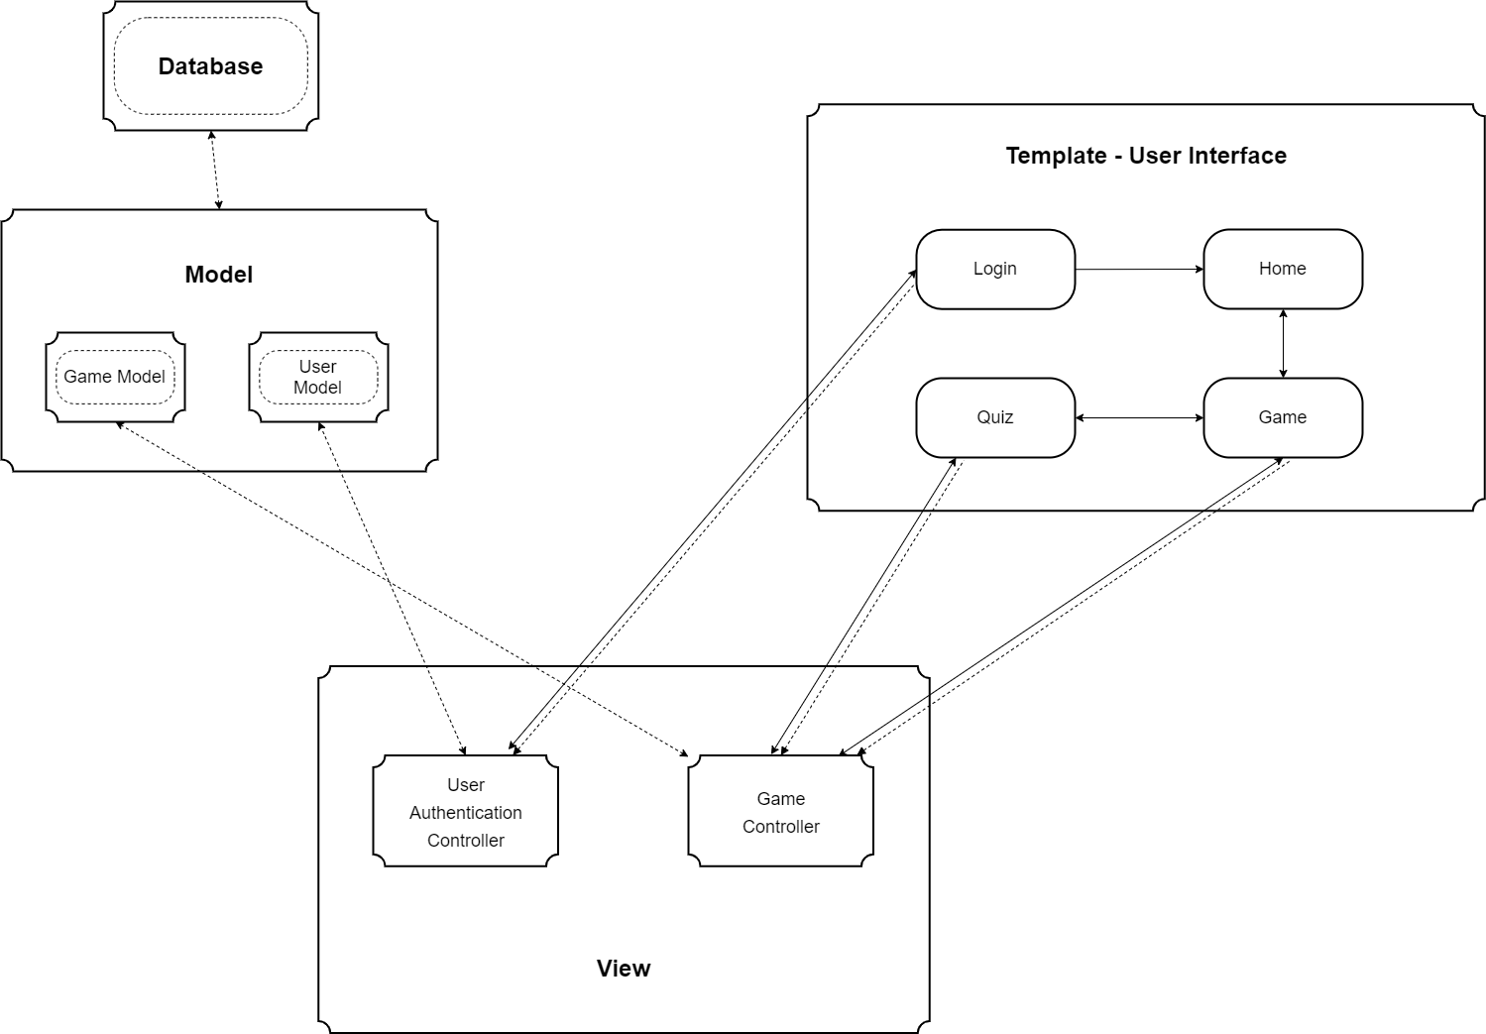
SYSTEM ARCHITECTURE - BACK END
MVT Architecture
Model
View
Template
Notes:
"HUF" have chosen to adopt the Model-View-Template architectural style, as it merges best with the Django framework.
The MVT architecture separates the program into the Model, View and Template layers. Since each layer controls its own set of classes and functions, this allows for easy maintenance of the program. Communications between the layers (Model, View, Template) are in the forms of HTTP requests and responses. The Template layer is the user interface of our program, containing all the classes which the user is allowed to interact with and view, such as the leader board. It receives input from the user.
We have chosen the Model View Template Style over the Model View Controller Style over other architectural styles because modifications are easier in MVT (tables can be created in Models in Django without needing to write complex SQL code) and communication between the View layer, Model and Template layers is handled by the Django framework, allowing for rapid development. As a result, modifications to the platform will come at low cost in the future.
Now, Song Yu will talk about the system architecture of the front end.

Slide 19
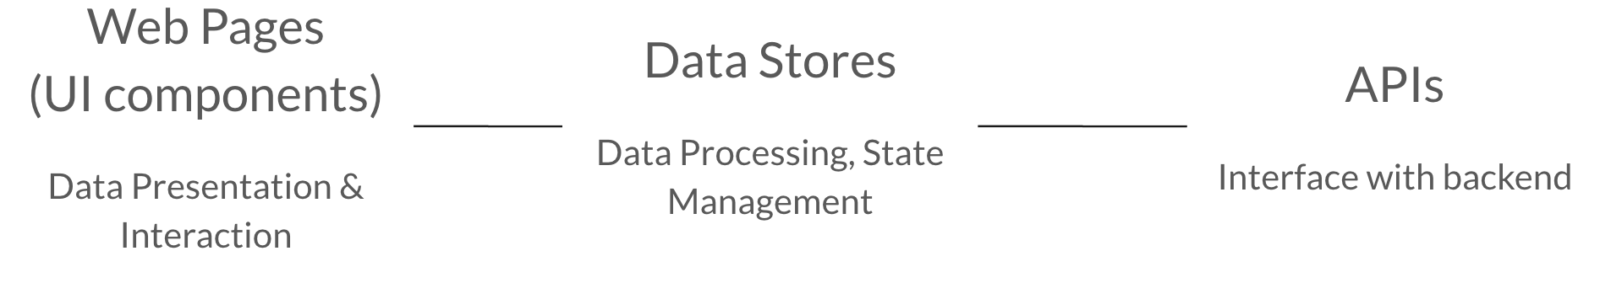
SYSTEM ARCHITECTURE - FRONT END
Our Front-end
Tech Stack
Front-end
architecture
JavaScript (ES6)
React.js
HTML
CSS
Notes:
For the frontend development of HUF, we decide to use the tech stack that is currently very popular in the industry, including JavaScript ES6, React.js, HTML, and CSS.
With the help of react, which is a free and open-source front-end JavaScript library for building user interfaces or UI components, we will be able to build a responsive, powerful, yet developer-friendly app.
For the front-end architecture, we divide the code base into 3 main parts, including Static Web Pages or (UI components), Data stores, and APIs.
The APIs part is a collection of pure functions that directly connects with the backend.
They are used to make API calls to handle HTTP requests and responses for data transferring between the frontend and backend.
The UI components are the elements that users immediately see and interact when our website is loaded in their browsers and rendered on the screen.
In the UI components part, we have generic UI components, which are the reusable building blocks such as buttons, text inputs, and the overall layout that can be combined to realize complex business logics.
We also have complex components of web pages that corresponds to the different pages in our website.
The only 2 responsibilities of UI components are data presentation and user interaction.
As for the Data stores, they act like a middleman that works between the APIs and UI components.
They are used to convert the data from the result of API calls into a manageable state in the memory so that UI components can easily access.
Think of a restaurant, if UI components are the customers, APIs are the Chefs, then Data stores in this case are the waiters who help to deliver dishes elegantly.
Using this architecture, we will be easily separate the responsibilities of different parts in the system for high cohesion and low coupling.
It is also very easy to maintain and scale the application in the future if new features are planned or any error is spotted.

Slide 20
06
Analysis Models
Notes:
Thanks Song Yu, we shall move on to talk about the analysis models that our group drew. We will start of with the context diagram.

Slide 21
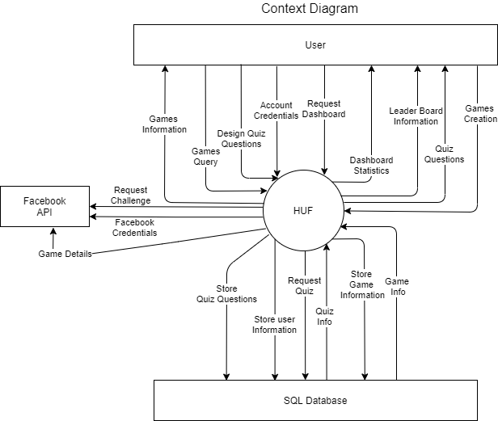
Context Diagram
Notes:
The context diagram shows the data flow between external entities and the Huf application. There are three main external entities that interact with the Huf application, namely the user, Facebook API and the SQL database.
When the user interacts with the browser, he/she will be able to perform several actions that will request data from the Huf application. For example, when the user taps on the <click> View Game page, the game query is sent to the Huf application. <click>This request for the page data will be sent to the Huf system to which the Huf system will load the page requested and displays it back to the user.
<click>The Facebook API external entity is used to send login credentials, request challenge and game details which is required for the facebook log in and challenge features.
The last external entity is the SQL database which is used in support the Backend features of the application. <click>For example, when the user creates a new account the new account information is send to the SQL database to be stored. Next Ashwin will be bringing you through the data flow diagram.

Slide 22
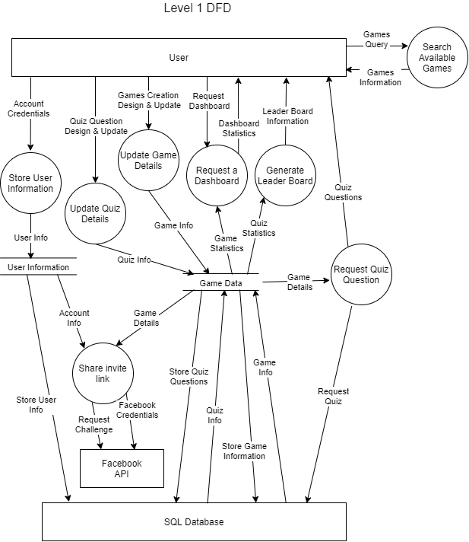
Data Flow Diagram
Notes:
Our data flow diagram is a map of the information flow in our system, which is a more expanded view of the context diagram. This is a level 1 Data Flow Diagram where we show further detail of the functions in our system.
For example, when a user wants to create an account, account credentials are sent from the user to the process "Store User Information"<CLICK>, which sends user info <CLICK> to the data store User Information. Following that, the data store would send User Info <CLICK> to the SQL Database where it would exist as persistent data. <CLICK>
The data stores used here are the Game Data and User Information, and these are the elements that are used to interact with the SQL database. For example, in the Update Game Details process, Game Information <CLICK> would be sent to the Game Data store, which would interact <CLICK> with the database to store the Game Information. Similarly, Game Information can be sent from the SQL database to the Game Data store.
Next Daniel will be talking to you about the ER Diagram.

Slide 23
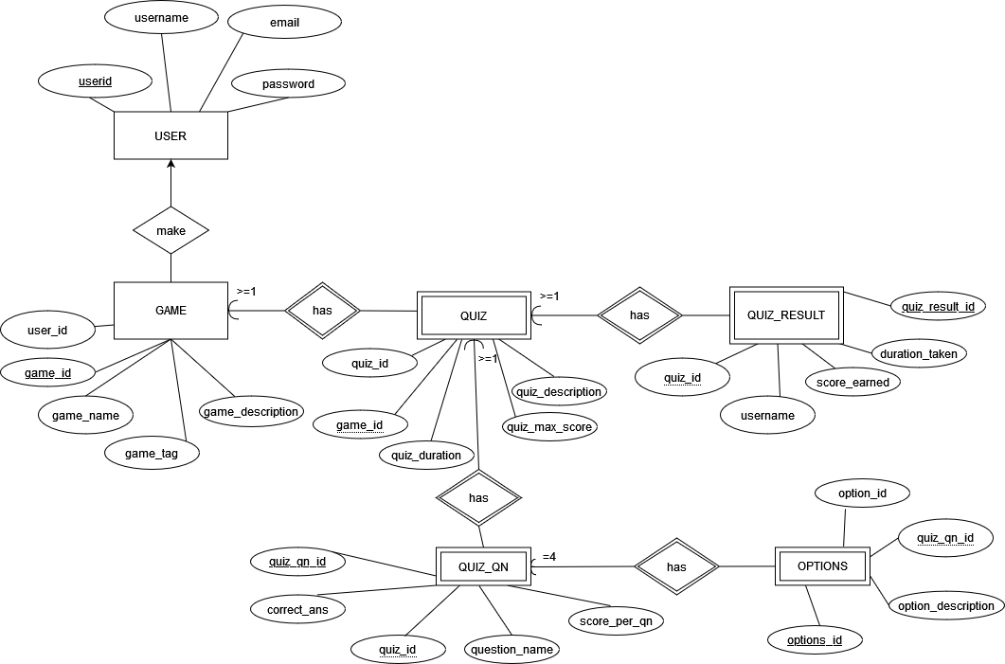
Entity Relationship Diagram (ERD)
USER
GAME
QUIZ
QUIZ_RESULT
QUIZ_QN
OPTIONS (QUIZ)
Notes:
6 Different Models (USER, GAME, QUIZ, QUIZ_RESULT, QUIZ_QN AND OPTIONS FOR QUIZ)
User - Store credentials of users
Game - Game Details
Quiz - Quiz Detail
Quiz Result - Result of each quiz done by user
QuizQn - Details of Question in Quizes
Options - Individual options for each question
We chose a relational database as we require our data across models to reference one another
All the models are linked together through foreign key relationship for instance GAME will reference user_id which in the USER table
Each Model has an id as PK (django does this automatically)
Only used 2 data type INT AND VARCHAR
INT to store integers like the ID, duration and score. Easier to compare values and has auto_increment feature
VARCHAR to store text like the name and description (storage length is equal to the length of the string)
Password for USER model is in varchar but encrypted for Django’ PBKDF2 algorithm with SHA256 hash
Some models have unique pairs for instance QUIZ_RESULT has quiz_id, username and OPTIONS has QUIZ_QN_ID, OPTION_NO
Nikita will talk about the Comms Diagram

Slide 24
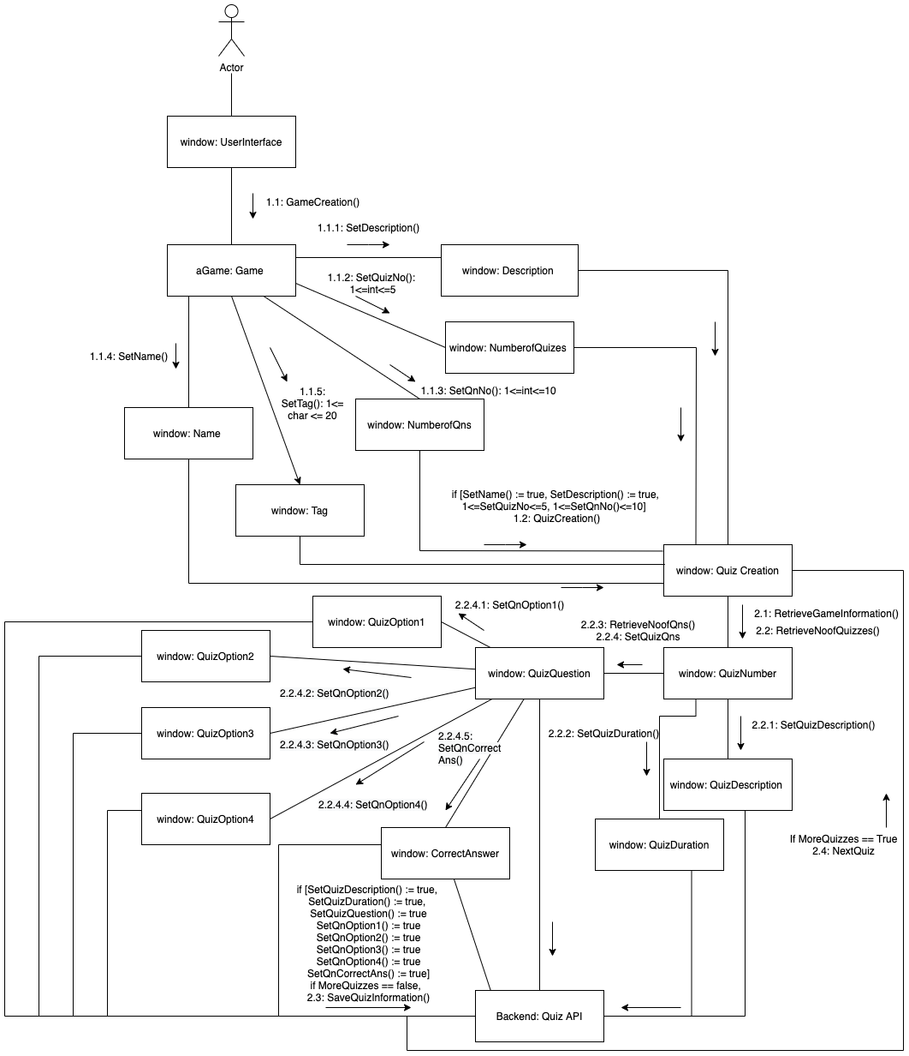
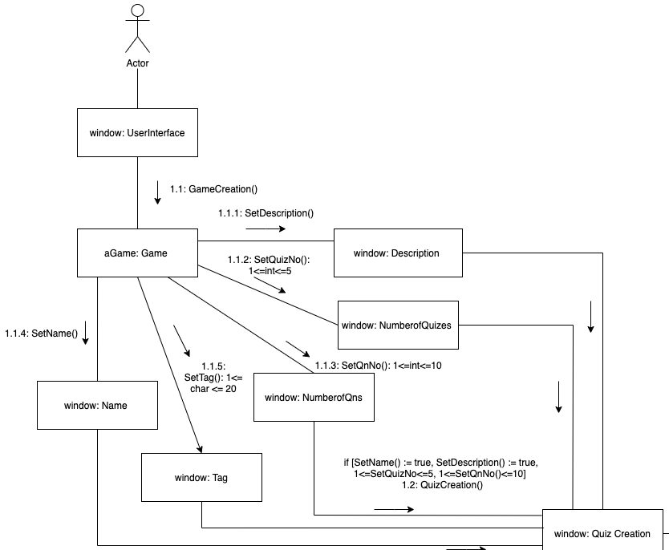
Communication Diagram
Game and Quiz Creation
Notes:
I am Bachhas nikita and i will now be presenting the the communications diagram for Game and Quiz creation.
<click>
Firstly, to create the game <click>
The user will click on the “create a game” button on the homepage.
<click>
Following this the user will be required to fill in the game name, the game description, the game tag, the number of quizzes he or she wishes for the quiz to have, followed by the number of questions per quiz. The Game name, quiz number and question number will be brought forward to the quiz creation page to allow user to create their quizzes for their games. The game description tells a player what the game is about and the game tag allows for characterisation of the game.
<click>
If all segments are filled in accurately, these information will now brought over to the quiz creation segment.
<click>

Slide 25
Communication Diagram
Game and Quiz Creation
Notes:
Now, let us take a look at the second part of game creation: quiz creation, in this communication diagram.
<click>
First, the system will retrieve the game information and number of quizzes that the user entered during the game creation stage.
<click>
Using this the system will then display the quiz creation page accordingly.
<click>
After this the user will be required to enter in the quiz description and quiz duration that he or she wants to set for that particular quiz.
<click>
Concurrently, the system also has retrieved the number of questions that the user previously set for each quiz.
<click>
The user now has to set the questions, the options for it and the correct answer for that question.
<click>
If the user has filled in all the information, and there is no more quizzes to be created, the game information along with the quiz information will be saved in the backend, under Quiz API.
<click>
If there is still another quiz to be created, the quiz creation process begins again.

Slide 26
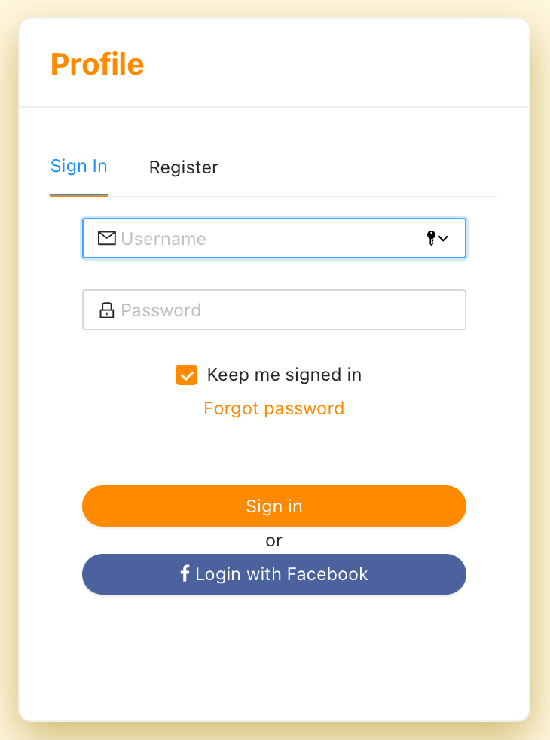
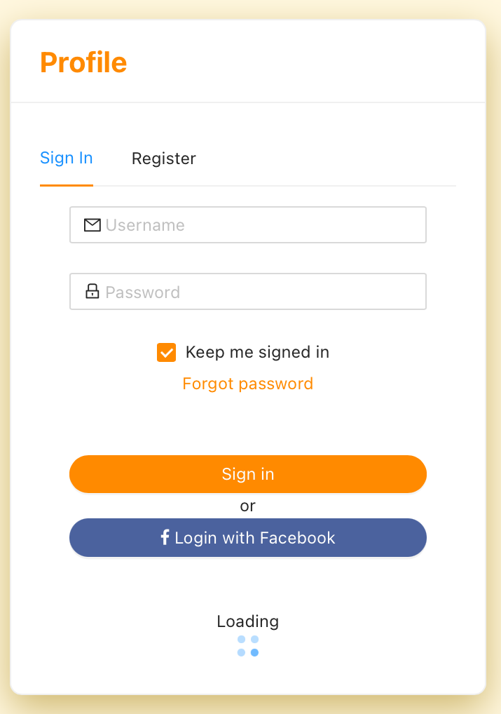
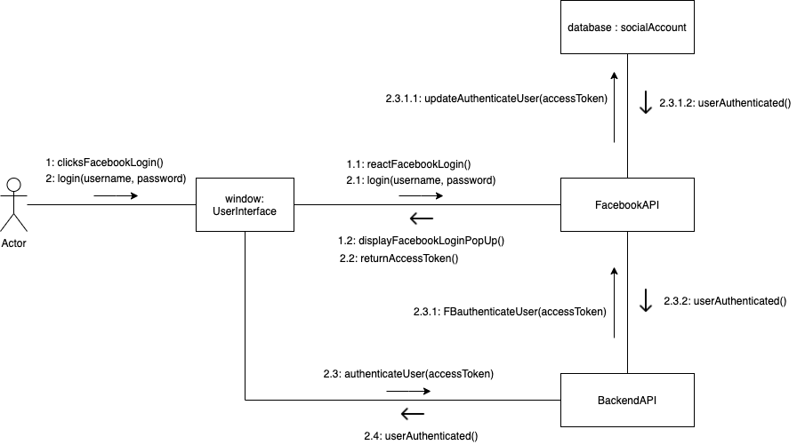
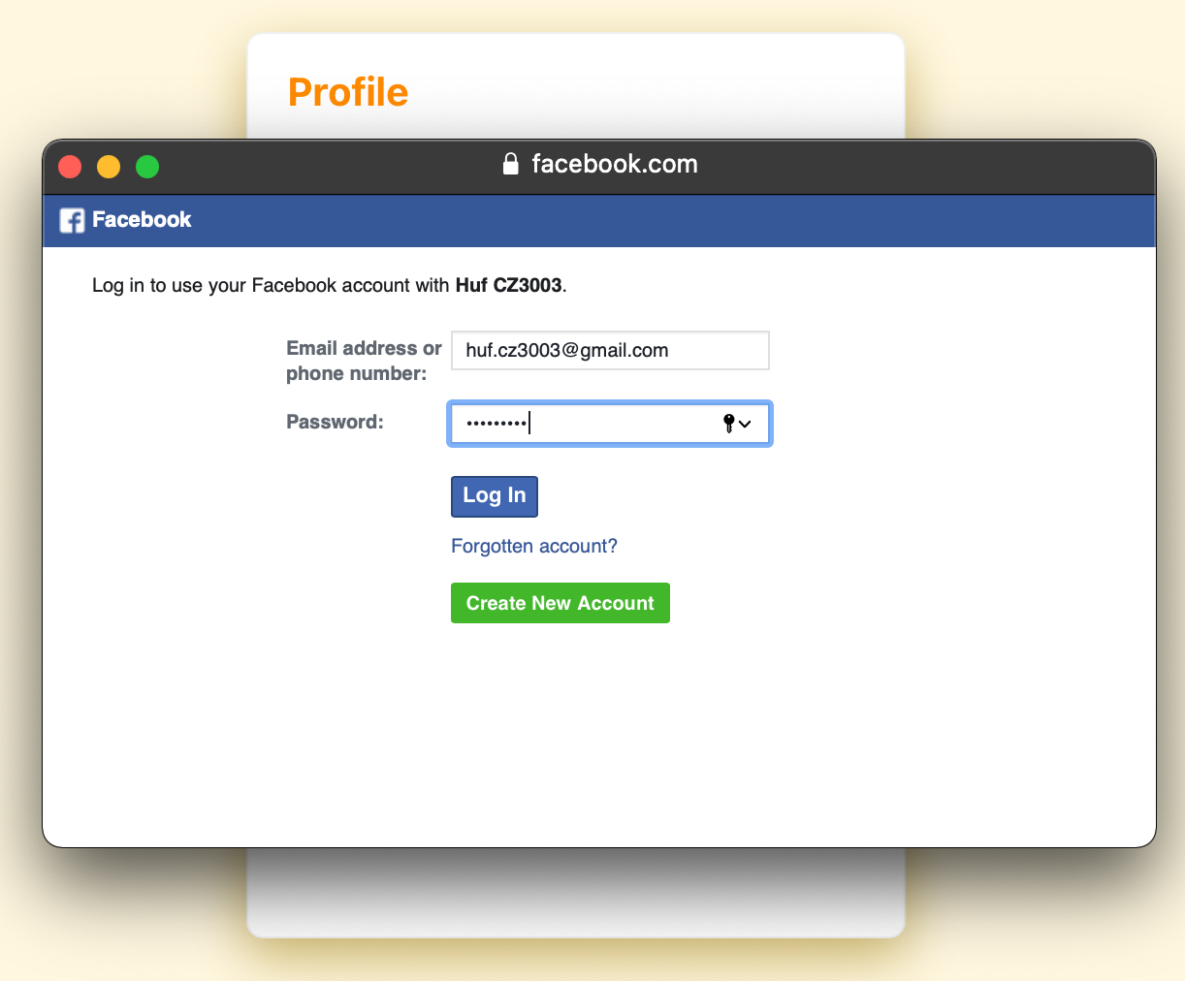
Communication diagram
Facebook Login
Notes:
Our app allows user to login via Facebook to enable a more convenient and secure login process.
To use the Facebook login feature, users can click on the Facebook login button on the login page.
<click>
This will call the FacebookAPI from the frontend, and Facebook API respond by redirecting the user to a <click> Facebook login pop up page.
The user will enter their Facebook username and password on the pop up page. Upon successful login, Facebook API will return the users’ access token.
<click>
Next,
the frontend interface will call the a backendAPI function and pass in the accessToken as a parameter to authenticate the user.
The backendAPI will call the FacebookAPI function and pass the accessToken as a parameter.
<click>
If the accessToken is valid, FacebookAPI will authenticate the user, and update the corresponding user details for that accessToken in the database.
On the other hand, if the accessToken is invalid, the user will not be authenticated.

Slide 27
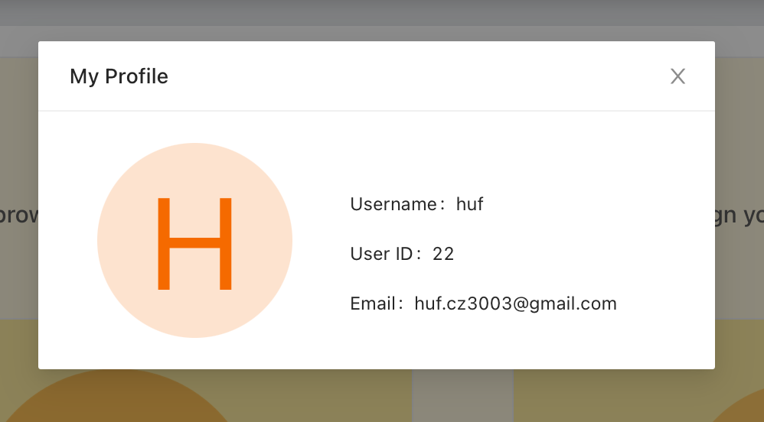
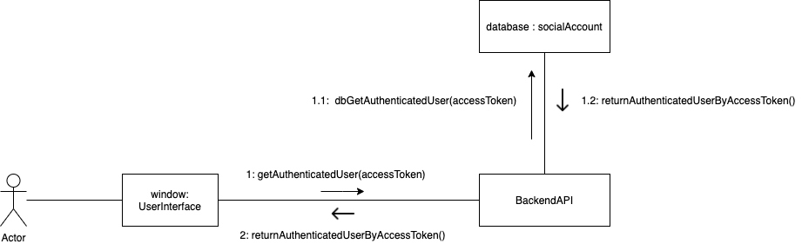
Communication diagram
Facebook Login
Notes:
As the database is updated upon successful authentication, the user details can easily be retrieved by calling the backendAPI by passing in the accessToken. This will return the authenticated users’ details.

Slide 28
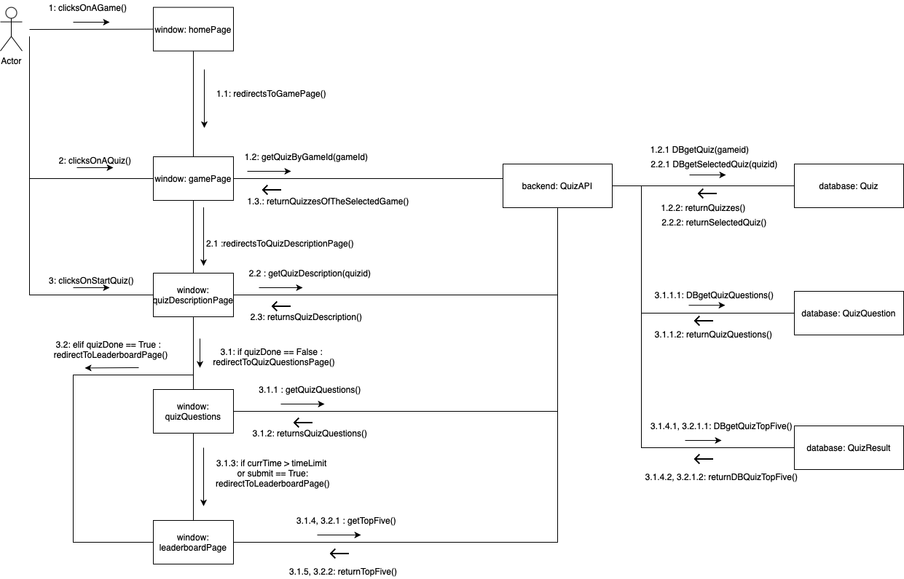
Communication diagram
Gameplay
Notes:
The communication diagram for the game play feature is as shown.
When the user wants to play a game, the user need to first click on a game on the home page.
<click>
This will redirect the user to the game page. On the game page, backend quiz api will be called to get the quiz of the game selected, and the backend quiz api retrieve from the database and return the quizzes of the selected game to the gamePage.
<click>
On the game page, user can click on one of the quizzes. This will redirect the user to the quiz description page.
The backend api will be called to get the quiz description of the selected quiz. backend api will then return quiz description on the quiz description page.
<click>
On the quiz description page, a user can click on the start button to start the quiz.
If the quiz has not been done by the user, the user will be redirected to the quizQuestionPage. Else, if the quiz has been done, the user will be redirected to the leaderboardPage.
Assume the quiz has not been done by the user, the user will then be redirected to the quiz questionPage. The backend function will be called to get the quiz questions, and the quiz question will then be displayed on the quiz question page.
On the quiz question page, if the time is up or the user clicks on the submit button, the user will be directed to the leaderboard page.

Slide 29
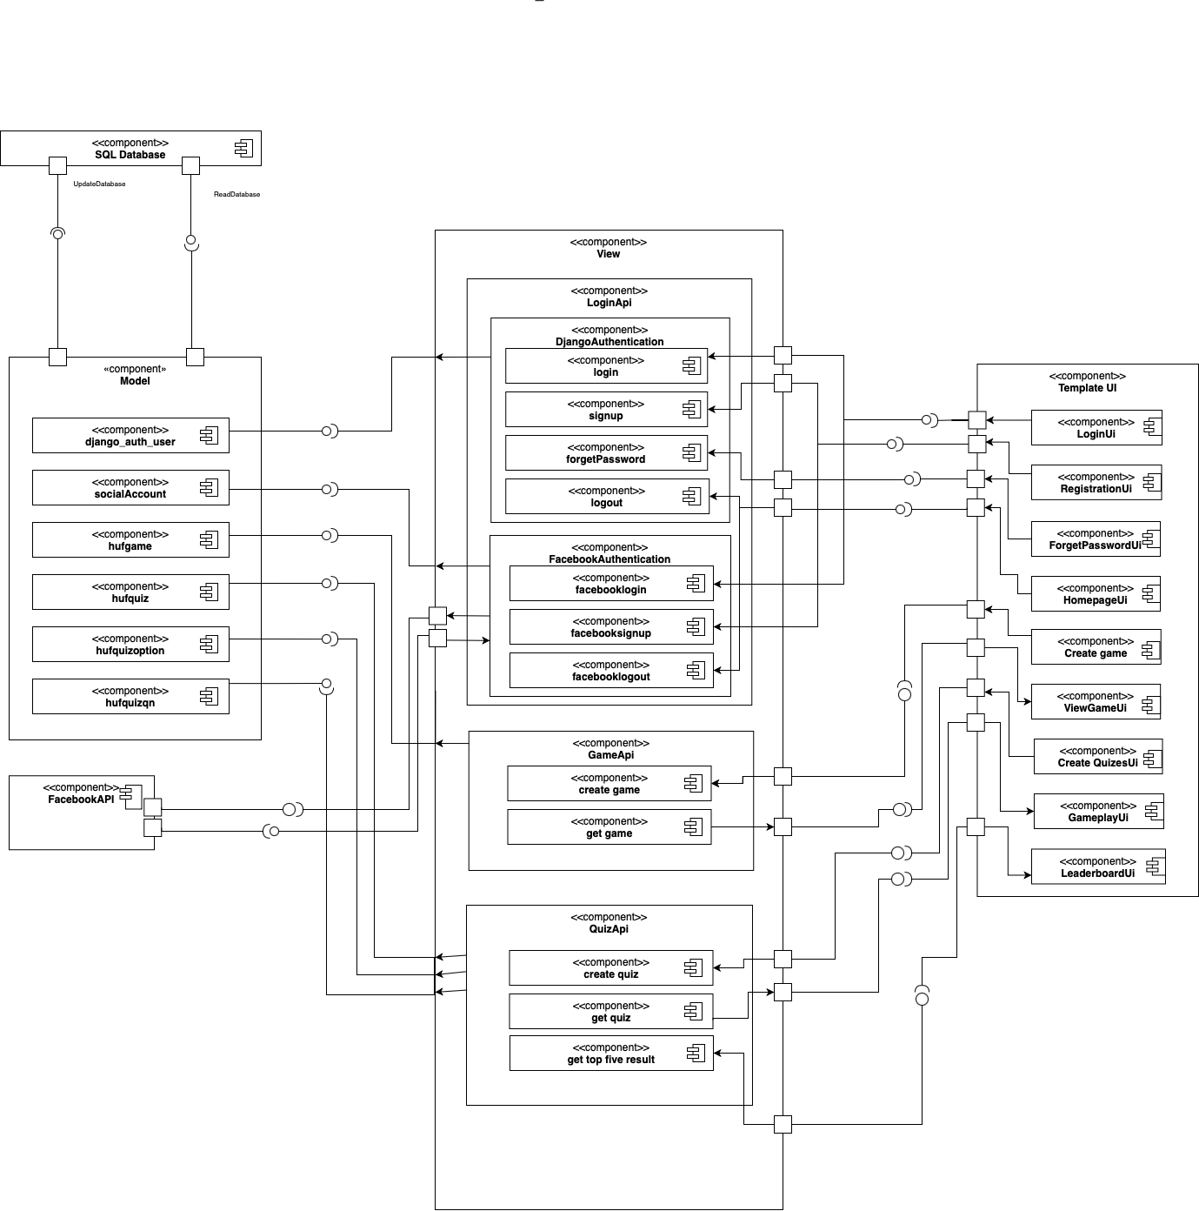
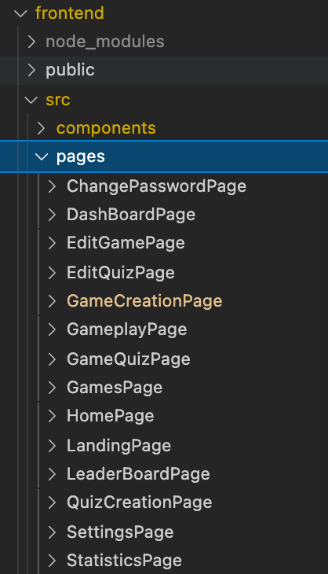
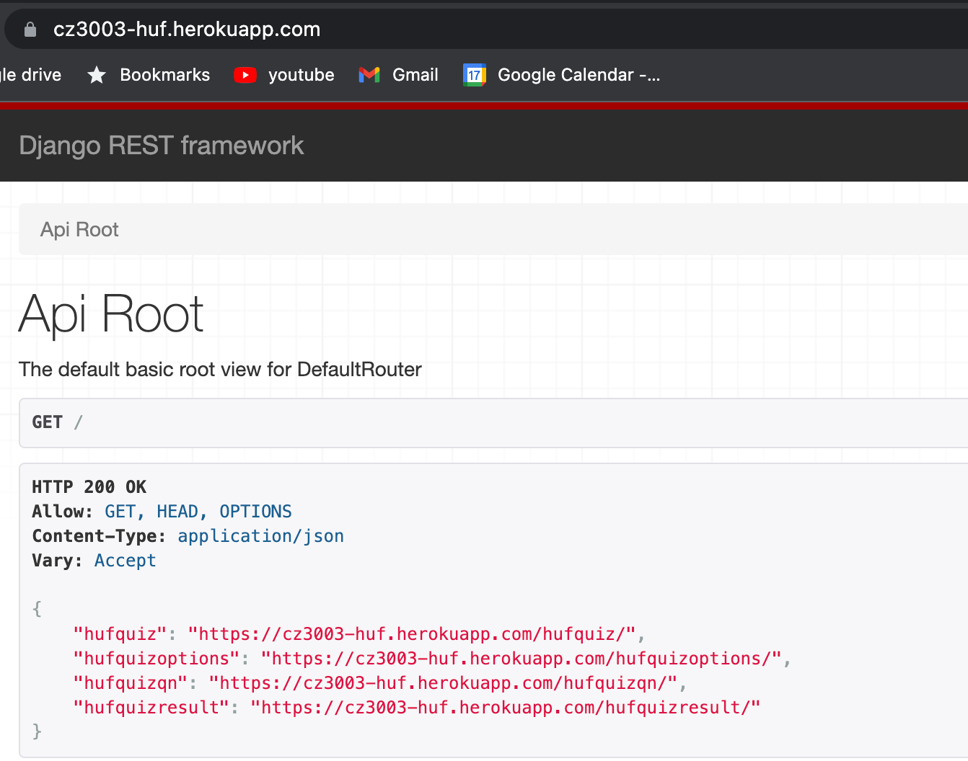
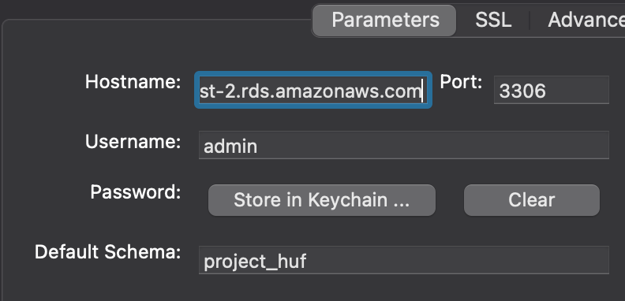
Component diagram
Notes:
The following is the component diagram of our application.
The SQL database, backend, and frontend are located in different ports.
The SQL database is deployed on AWS RDS.
<click>
The model and view components are part of the backend and the backend is deployed on heroku.
The model component contains subcomponents representing the database schemas while the view components contains the backend APIs, containing subcomponents namely the loginAPI, gameAPI, and quizAPI.
<click>
Lastly, the template UI component represents the frontend. Its subcomponents are the different pages on the app.
The component diagram shows that our application is highly decoupled, allowing application features for both the front end and backend, to be developed concurrently. This also reduce inter dependencies, so failures in one component does not impact other components.

Slide 30
07
Subsystem Interface

Slide 31
Subsystems
Login
Game Creation
Quiz Gameplay
Dashboard
Challenge
Considering core functional requirements.

Slide 32
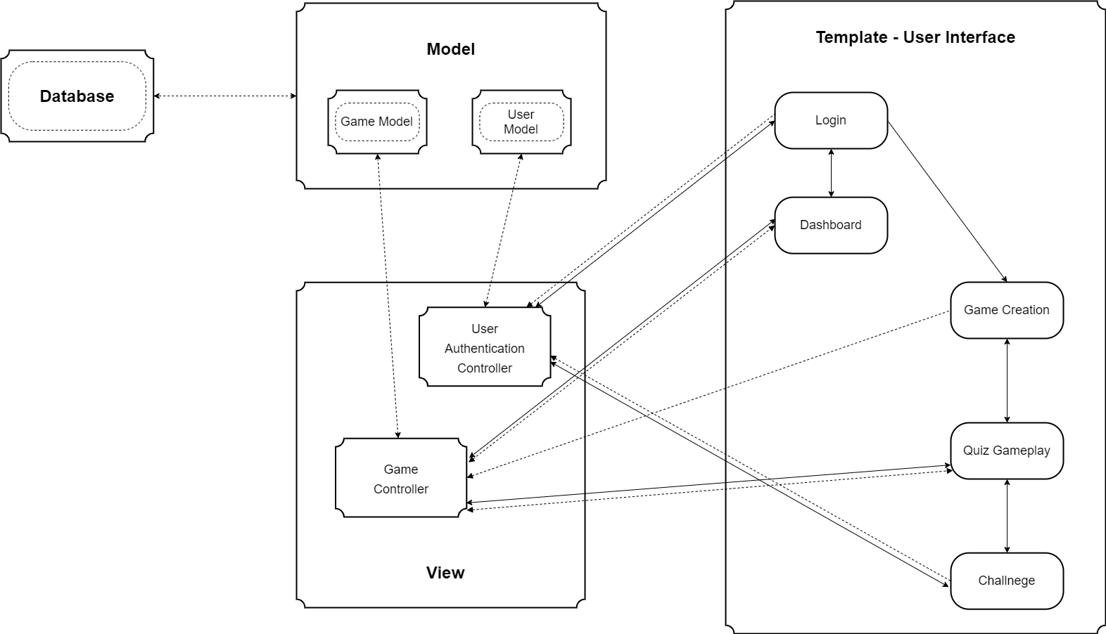
Subsystems (Visual Notation)
Notes:
Considering the messages that we require as well as how this messages are being passed around, we have divided up the whole system based on the 4 core functionalities requirements and designed 5 subsystems that is able to enact the key system usage scenarios.
For ease of understanding, I will use visual notations to go through the interface as well as some of the services and messages that are passed from one another.
**CLICK**
You will notice that the subsystems mostly reside in the template view and the rest remains the same as how it was shown in the system architecture. So i will focus mainly on the template view.
**CLICK**
login is essential and how it will work is it get the account details through apis from the user model and validated through the controller before granting access. **CLICK**
**CLICK**
**CLICK**
from there, control can either be passed to game creation or dashboard based on the users choice of action.
**CLICK**
If a user has already created games before and would like to view the statistics of the game, the control will pass over to dashboard
**CLICK**
and it will retrieve the information through the controller and display the information out.
**CLICK**
**CLICK**
Else if its to create a new game, the control will pass to create game and user can create the games,
**CLICK**
**CLICK**
once done, the data will be passed to the controller to store it in database. and during the
**CLICK**
**CLICK**
gameplay, it will retrieve the data that is needed for the quiz
**CLICK**
**CLICK**
and once the game is completed info such as the scores will be passed over to controller to store in database
**CLICK**
**CLICK**
before passing over control to challenge where they can use their facebook account to send invites to their mutual friends
**CLICK**
**CLICK**
through the help of user authentication controller.
**CLICK**

Slide 33
08
Testing Methods
Notes:
Thank you Tian Quan. My name is Teng Sok Ee and I will be going through our groups testing methods. -click-

Slide 34
01
02
Testing Methods
03
BLACKBOARD TESTING
SYSTEM TESTING
INTEGRATION TESTING
Notes:
For testing methods, i will be talking about our testing strategies and techniques. It includes using Black Box Testing, System Testing and Integration Testing. -click-

Slide 35
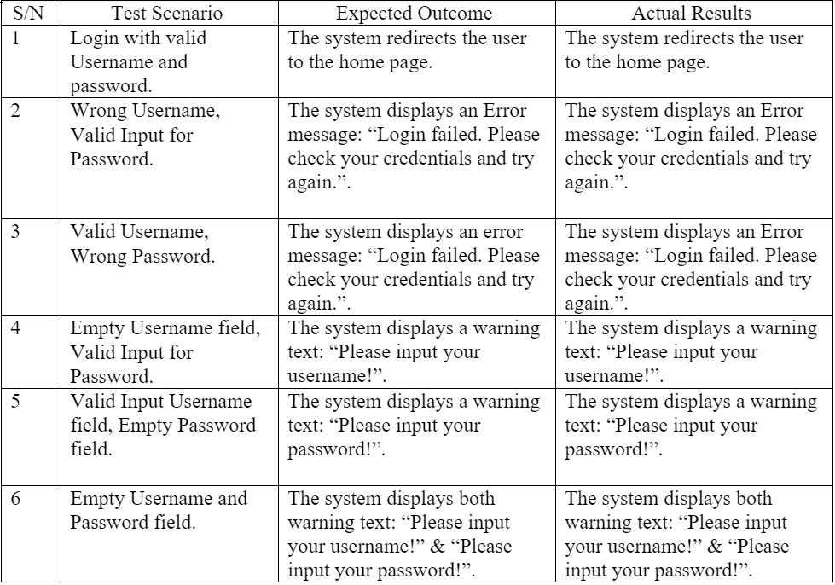
Blackbox Testing
Login
Notes:
Black Box testing was used to test systems like login, game creation, etc where different inputs can be tested easily for correctness.
We entered different inputs into the system, valid and invalid, and checked that the expected outcome was achieved. This is an example of one of out blackbox test cases.
We also utilised unit testing to check whether our database recorded correct information for users. -click-

Slide 36
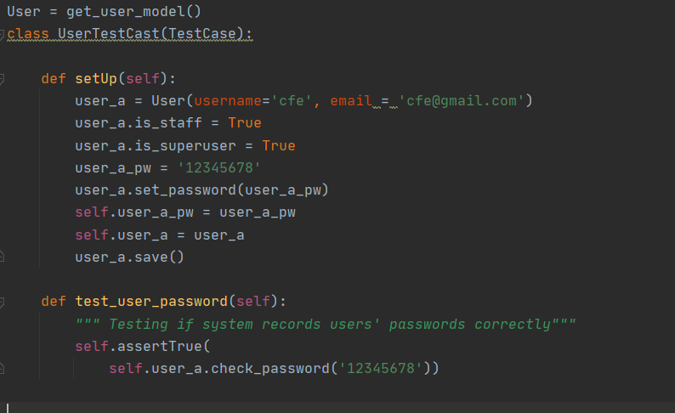
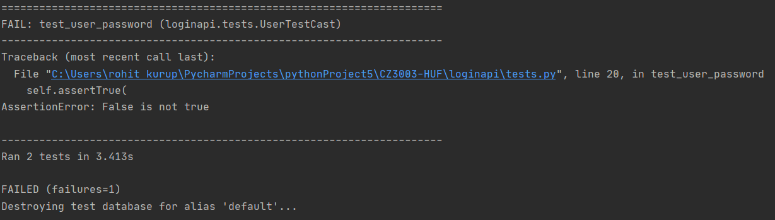
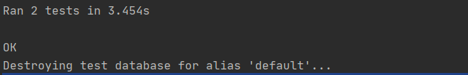
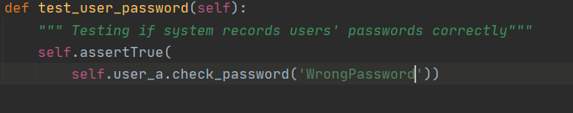
UNIT TESTING FOR PASSWORD INPUT
Notes:
For unit testing, we utilised Django's in built testing framework. For this example for unit testing for password input, we generated a user using the get_user_model from Django's authentication library and saved a password for that user. For testing, Django created a replica of our database and checked the result of a user trying to log in with the wrong password. This is the test case for when user inputs a valid password -click- -click- And this is the test case for when user inputs an invalid password -click-

Slide 37

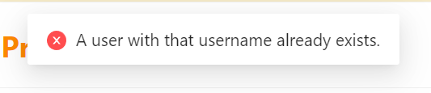
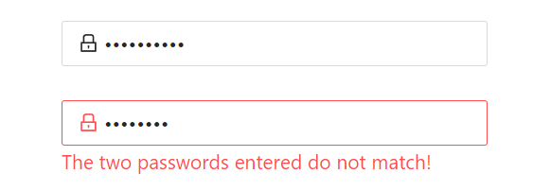

SYSTEM TESTING
Functional Testing - Registration
Invalid Email | Username already taken
Invalid Password | Password Mismatch
Notes:
System testing is a validation test that is performed to ensure that the requirements of the system matches the functional and non-functional requirements. This testing will help to surface limitations that the software has. We decided to carry out manual functional testing as our app is small sized but complex, therefore manual testing would allow us to test more scenarios under a shorter period of time to verify correctness. These are some examples of what we manually tested and its outputs. -click-

Slide 38
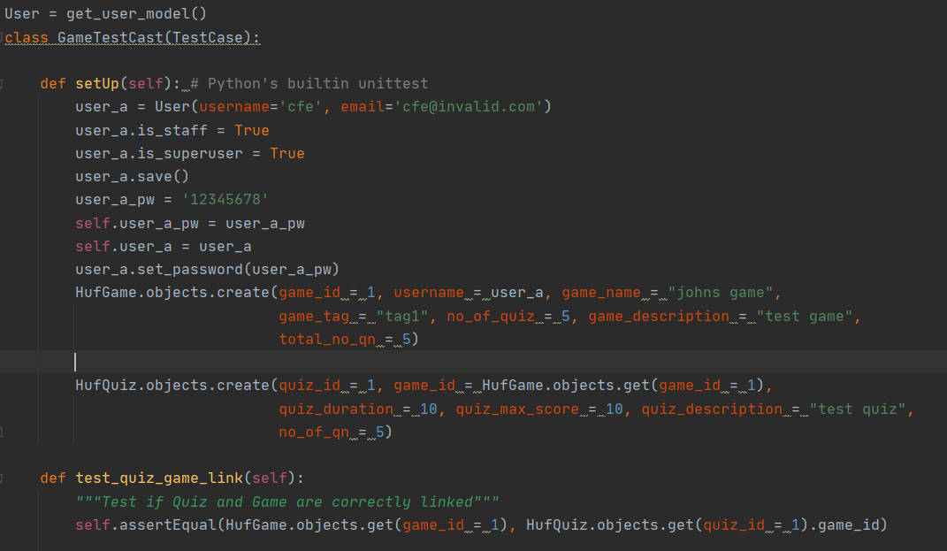
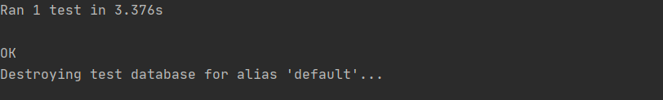
INTEGRATION TESTING
Creating a quiz under a specific name
Notes:
For this integration test, similarly to in unit testing, we employ Django's in build testing framework.
We create an instance of HufGame that would be stored in the HufGame Model, following which we create an instance of HufQuiz that would be contained in that HufGame Model, since it would contain the foreign key of the game_id HufGame created.
To run our test function, a copy of our database is created, we are testing here that the HufQuiz instance that we created is indeed linked to the HufGame instance. -click-
Our test returns OK (meaning that the assertEqual function shows that the HufQuiz and HufGame are linked in the database), therefore our database is working soundly.
To save disk space, the copy of our database that django creates is automatically deleted after the test is run. -click-

Slide 39
01
02
CONCLUSION
03
Meet targeted deadlines and software development goals
Further understanding on Django framework and React Library
Implement learnings from module in real life application
Notes:
We are able to meet our target of, making a web application for students and teachers to enhance their learning.
Through making this application we are able to enhance and learn more about how django and reactjs works.
Finally, this module has further enhanced our knowledge on the software architecture design through real life applied learning
In conclusion, our application is able to give students more opportunities to practice and test their knowledge and understanding of what is being taught through a friendly competition within a stress-free environment in the game, rather than through continuous tests that have permanent effect on their grades. Encouraging them to learn more through our proposed application. -click-

Slide 40
Thank You!
Notes:
Thank you. -end-

